Slide 1
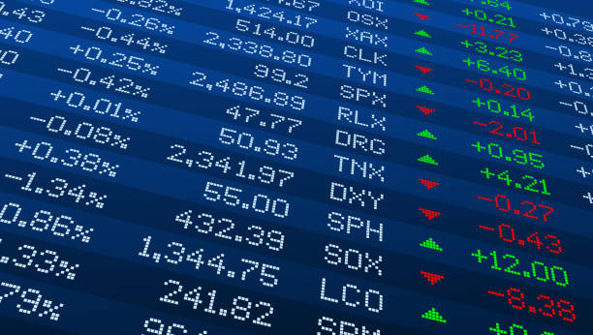
Upgrad Capstone Project
Finance and Risk Analystics

Slide 2
Agenda
Summary Profile of two Investors
Visulization Of Actual Stock Values, Normal Stock Values, Stock Daily Return, Stock Price Dispresion from Mean & Correlation Among stocks
Sector wise Trend Performance
Suggested Portfolio of Mr Patrick Jyenger
Daily Return
Suggested Portfolio of Mr Mr Peter Jyenger
Daily Return
Summary

Slide 3
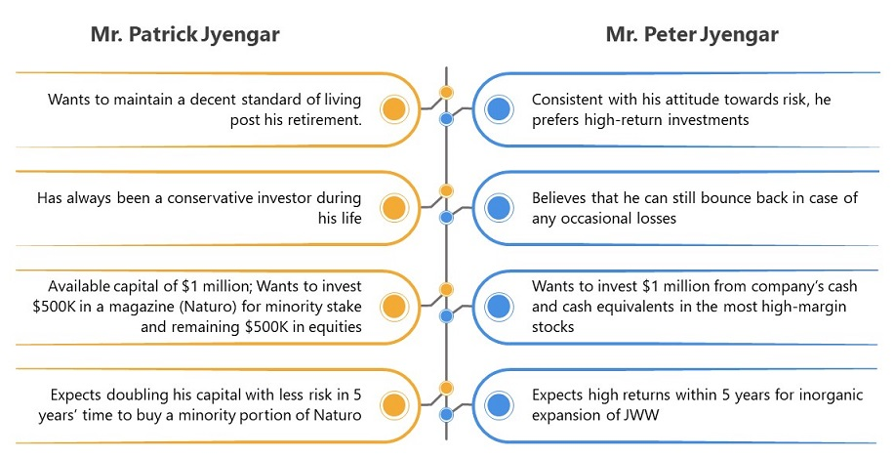
Summary Profile of two investors
Create a portfolio for the investor Mr Patrick Jyengar & Mr Peter Jyengar.
Mr Patrick is a safe investor & Mr Peter is risk taking investor.
Mr Partrick want to invest half million in equity & want low risk & Mr Peter want to invest 1 million & is ok with high risk taking stocks

Slide 4
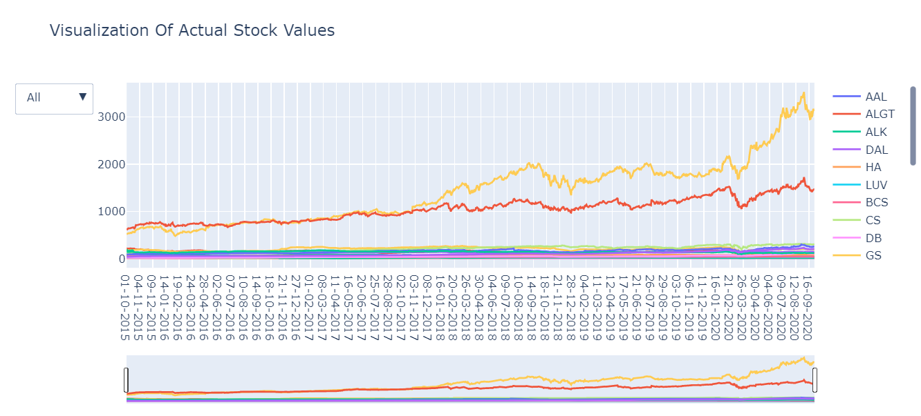
Visulization Of Actual Stock Values

Slide 5
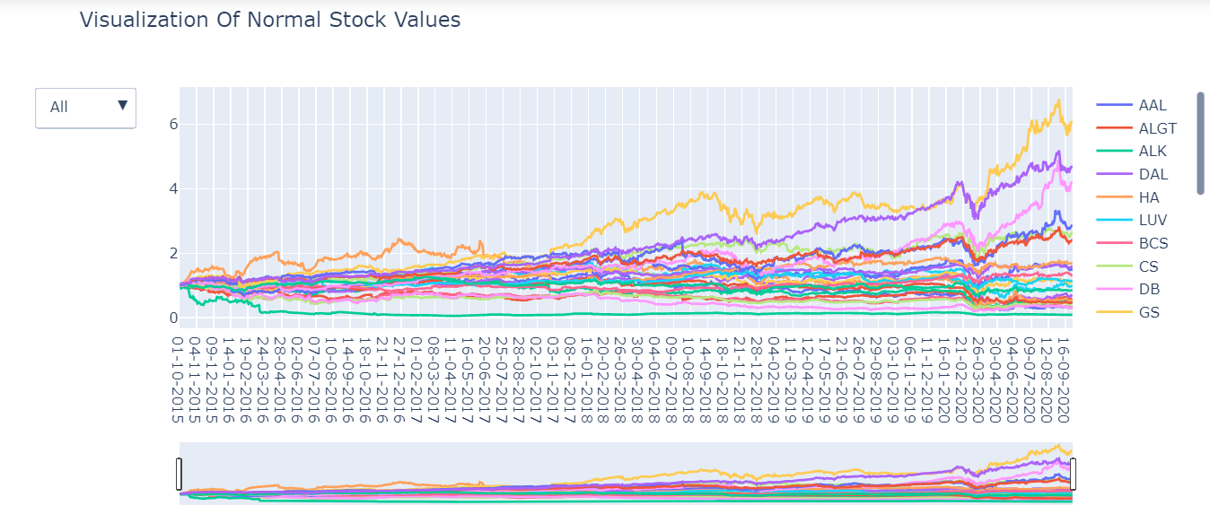
Visualization of Normal Stock Values

Slide 6
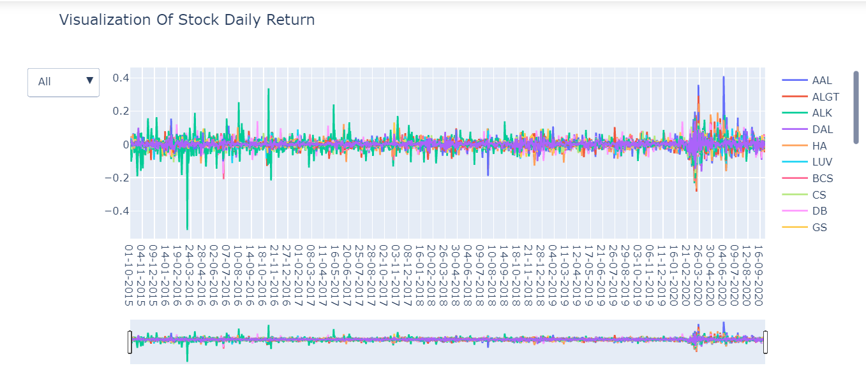
Visualization of Stock Daily Return

Slide 7
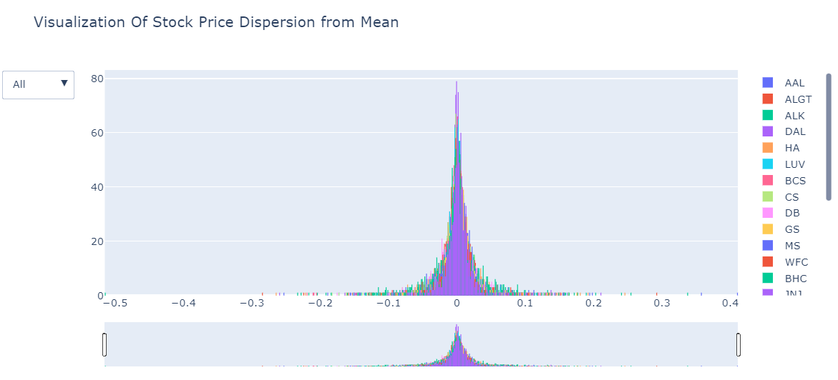
Visualization of Stock Price Dispresion from Mean

Slide 8
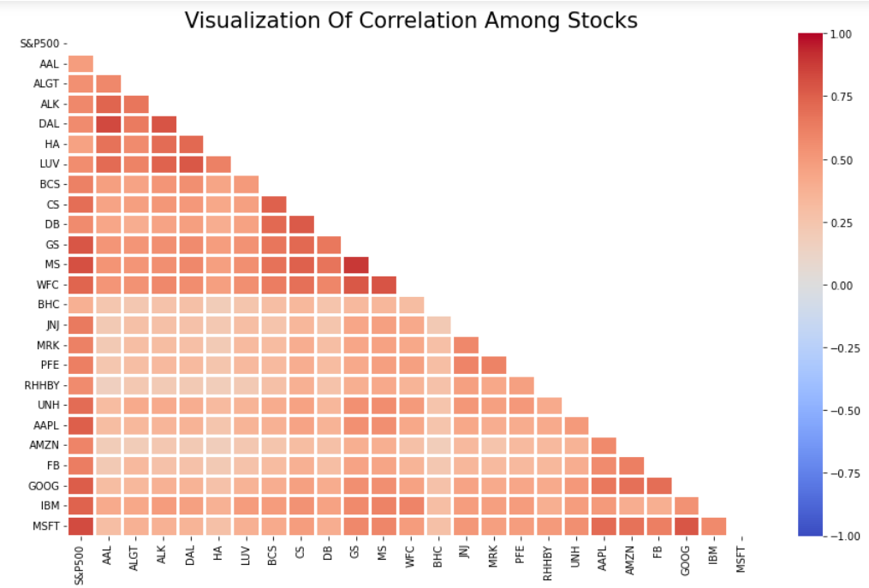
Visualization of Correlation Among stocks

Slide 9
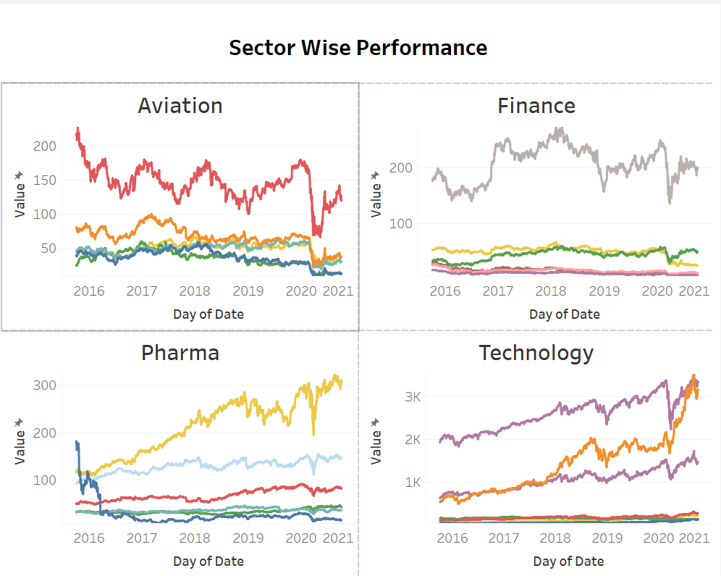
Sector Wise Trend Performance
Due to Covid-19/Lockdown aviation sector was badly effected as a result we can see from visual that Technology & Pharma Healthcare stocks have performed better & have given better return on investment than Aviation & Finance stock.
Finance stocks have performed worse than other three sectors stocks.
After looking into sector wise performance we will only suggest to invest in Technology & Pharma stock only for better return with less risk factor than Aviation & Finance stock which might have high risk with low/high return on investment as per market trend.

Slide 10
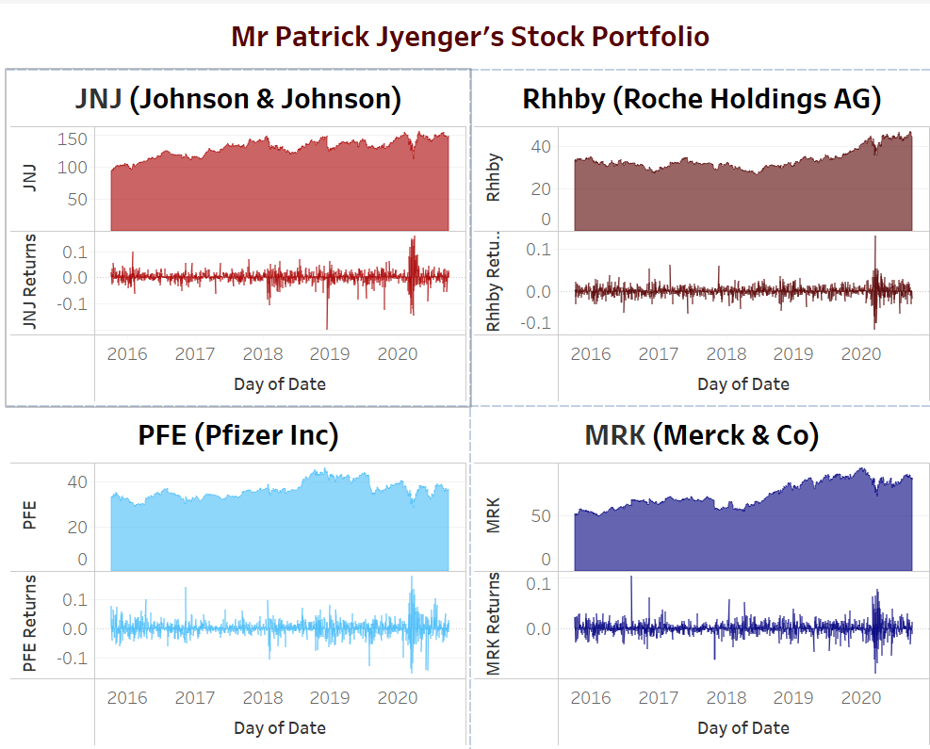
Portfolio for Mr Patrick Jyenger
Mr Patrick is a safe investor & want to invest half million in equity & want low risk
He should invest in Pharma Healthcare stocks like JNJ, Rhhby, PFE & MRK for to get 2.4X returns with a 21% risk factor on his investment

Slide 11
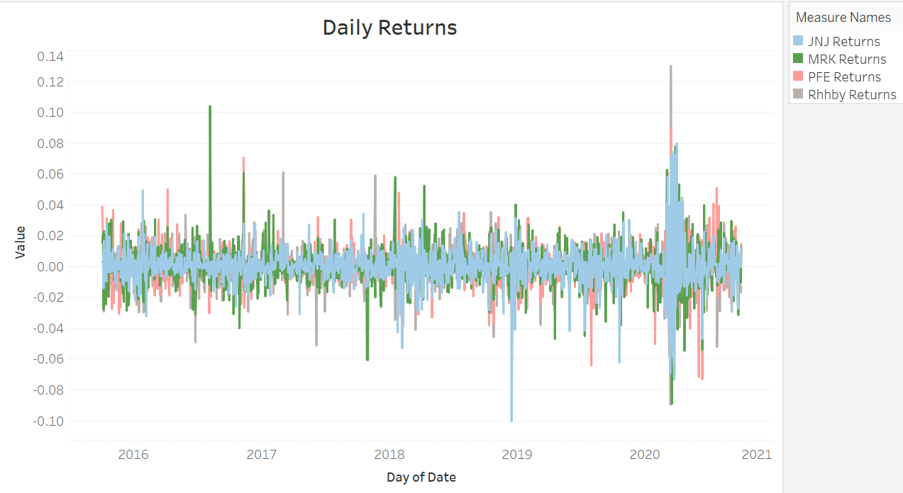
Mr Patrick Jyenger Daily Return on Investment

Slide 12
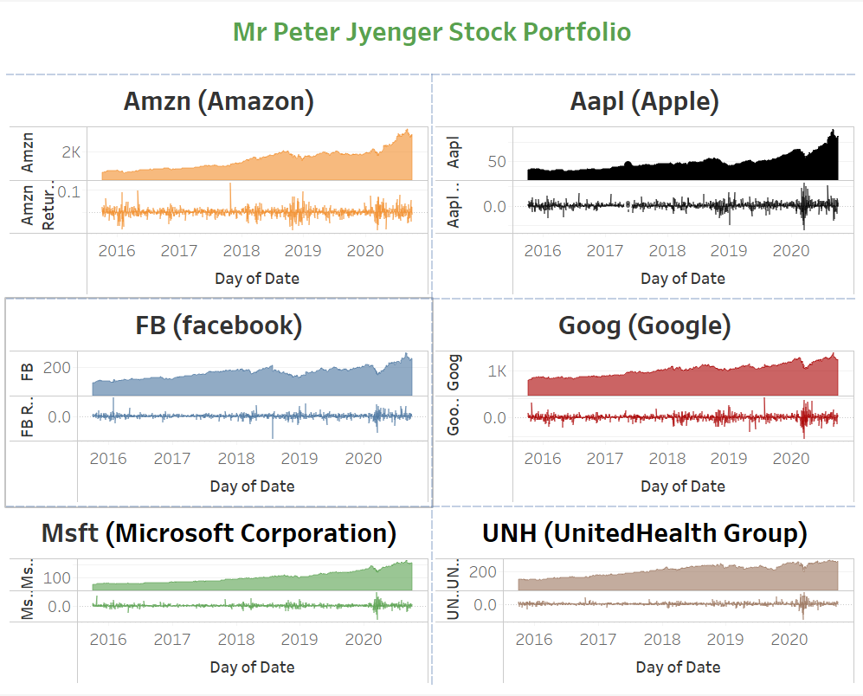
Portfolio for Mr Peter Jyenger
Mr Peter is risk taking investor & Mr Peter want to invest 1 million & is ok with high risk taking stocks
He should invest in Technology sector stocks like Amzn, Aapl, FB, Goog, Msft & Pharma stock like UNH for a 4X return with a 29% risk factor in his investment.

Slide 13
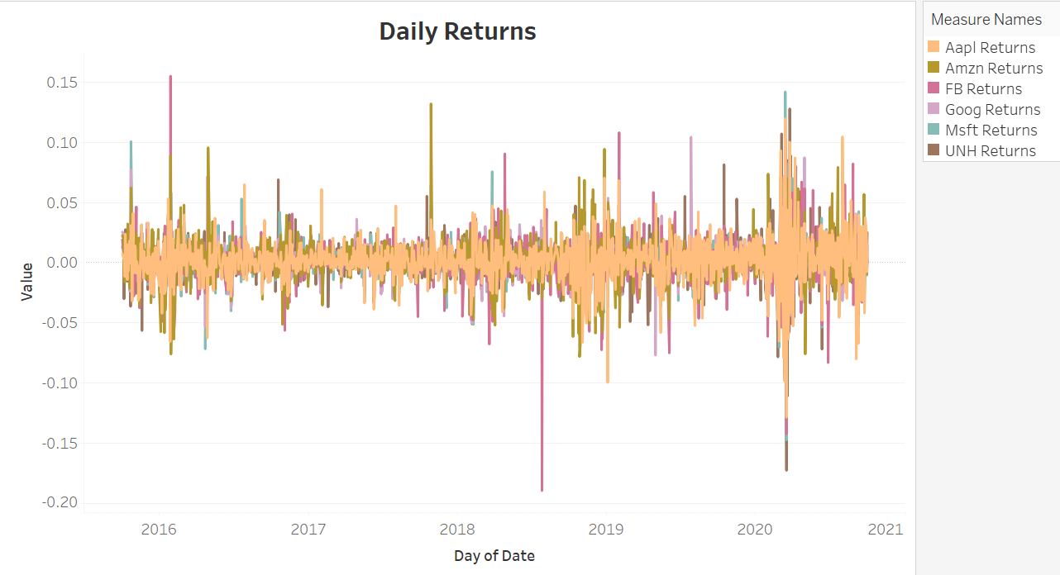
Mr Peter Jyenger Daily Return on Investment

Slide 14
Summary
Sector wise Trend : After looking into sector wise performance as well as Visulization Of Actual Stock Values, Normal Stock Values, Stock Daily Return, Stock Price Dispresion from Mean & Correlation Among stocks we will only suggest to invest in Technology & Pharma Healthcare stock only for better return with less risk factor than Aviation & Finance stock which currently have high risk but also does not guarntee for better return on investment as per current market trend.
Mr Patrick is a safe investor & want to invest half million in equity & want low risk so we suggested him to invest in JNJ, Rhhby, PFE & MRK.
Mr Peter is risk taking investor & want to invest 1 million & is ok with high risk so we suggested him to invest in Amzn, Aaapl, FB, Goog, Msft & UNH

Slide 15


